Slide 1
Shahad Alshamrani 2111855 Lara Alofi 2110886
LAB1: WORKING WITH PYTHON

Slide 2
downloading Python
First, I downloaded the Anaconda distribution from the Anaconda website, making sure to choose the version compatible with my operating system. After the download completed, I followed the installation instructions provided by Anaconda to set it up on my machine. Once Anaconda was installed, I launched Anaconda Navigator, where I found Spyder listed among the available applications. Clicking on Spyder opened the IDE for me. With Spyder installed, I'm now ready to start coding in Python

Slide 3
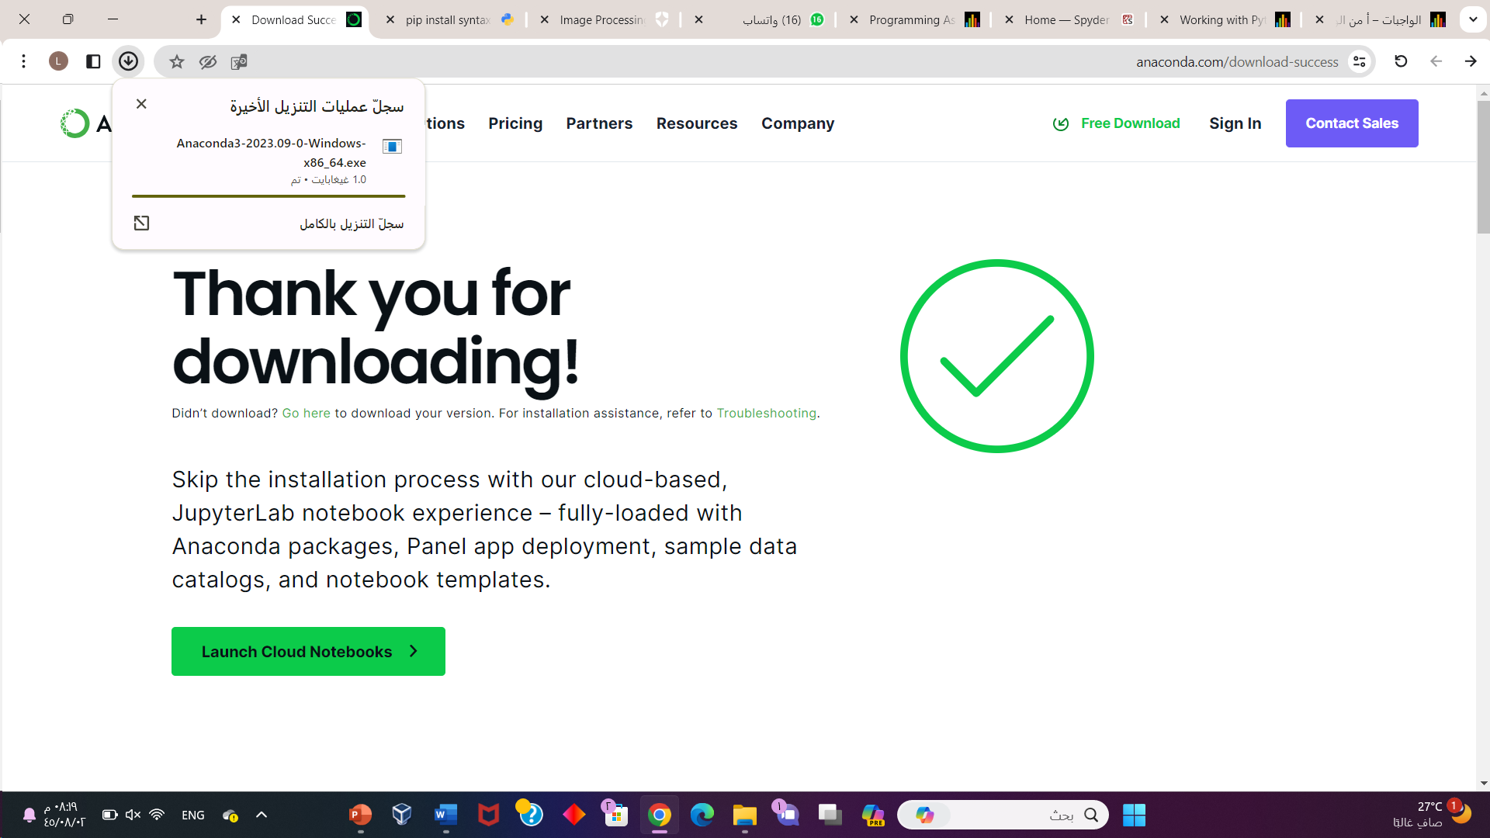
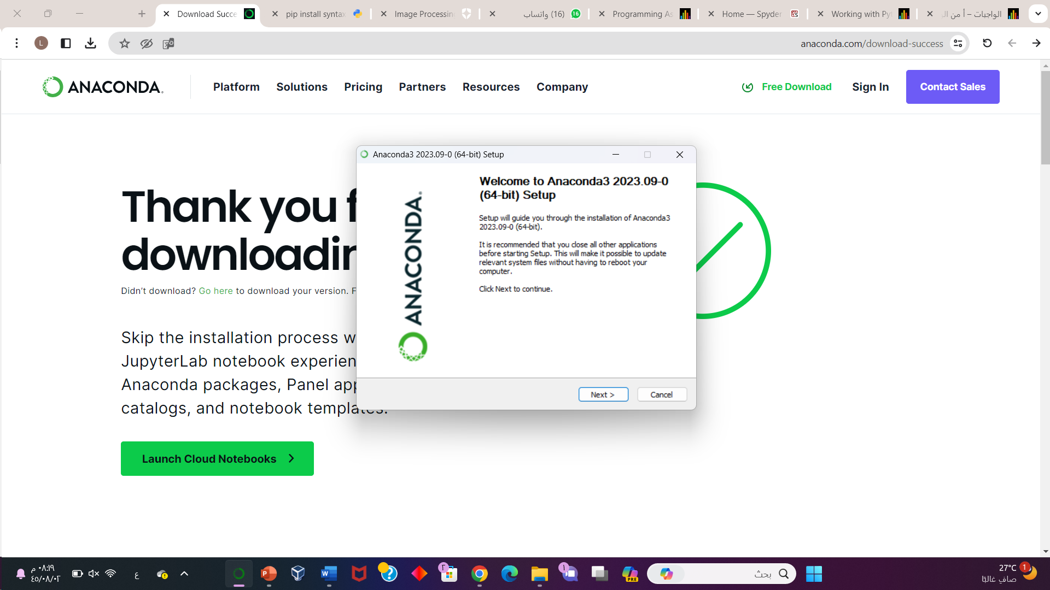
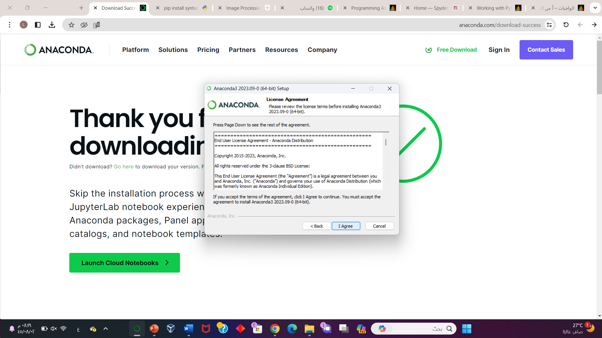
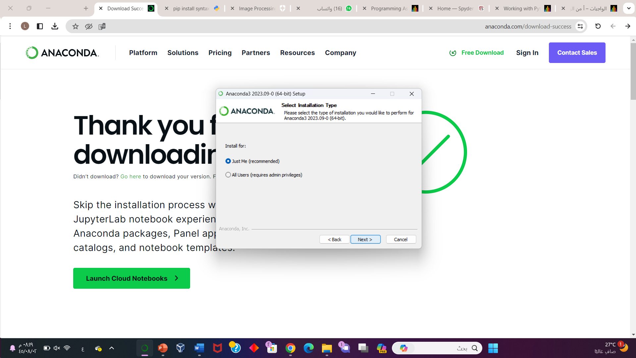
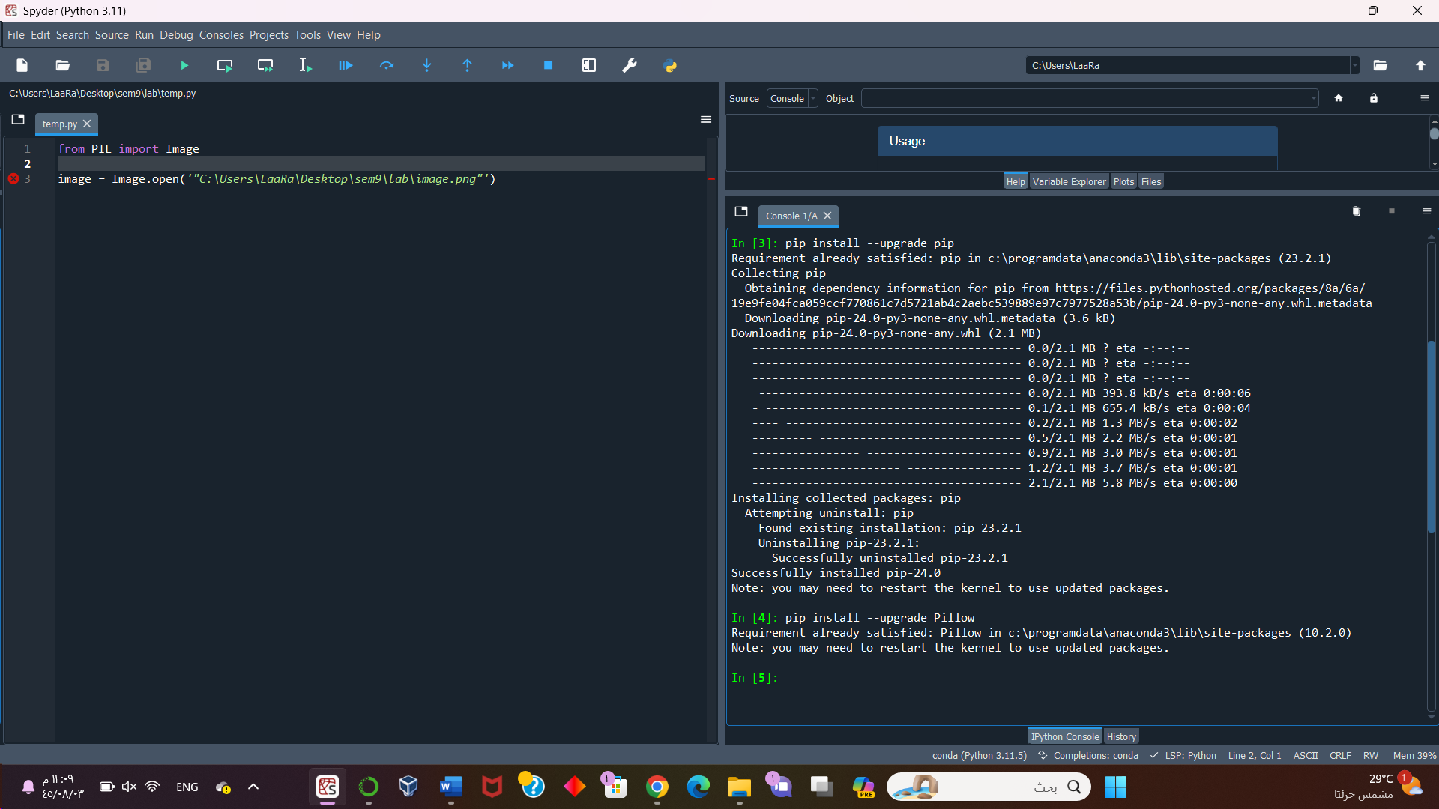
downloading Python

Slide 4
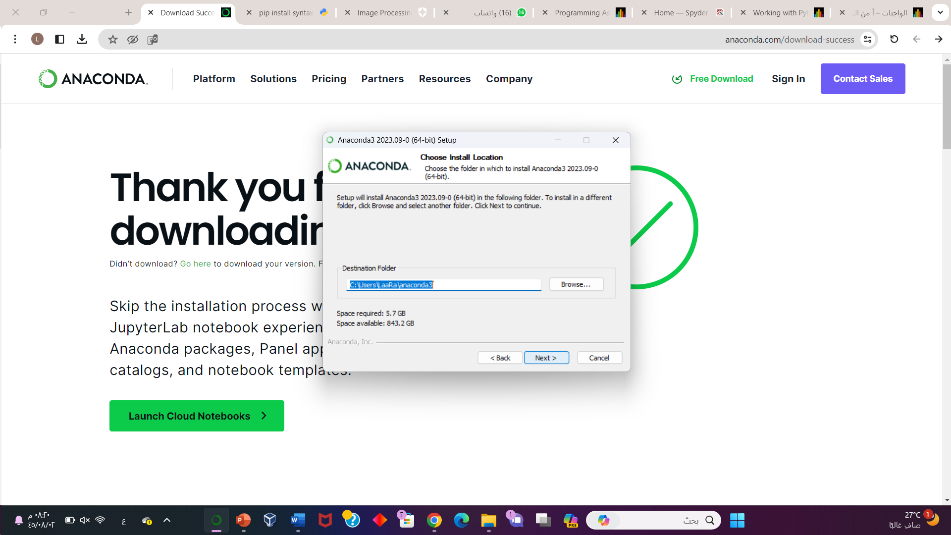
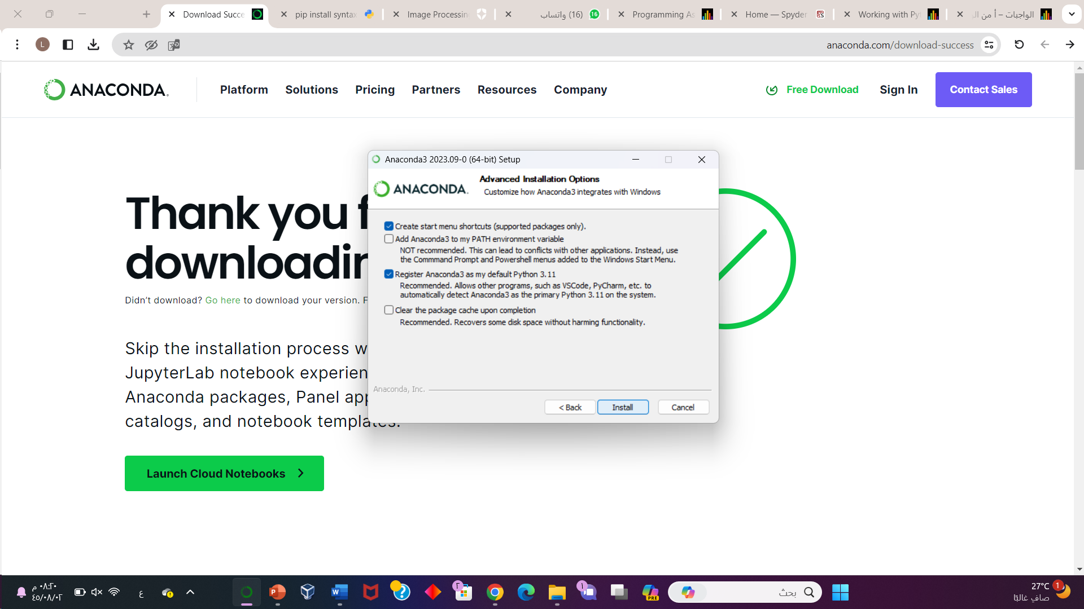
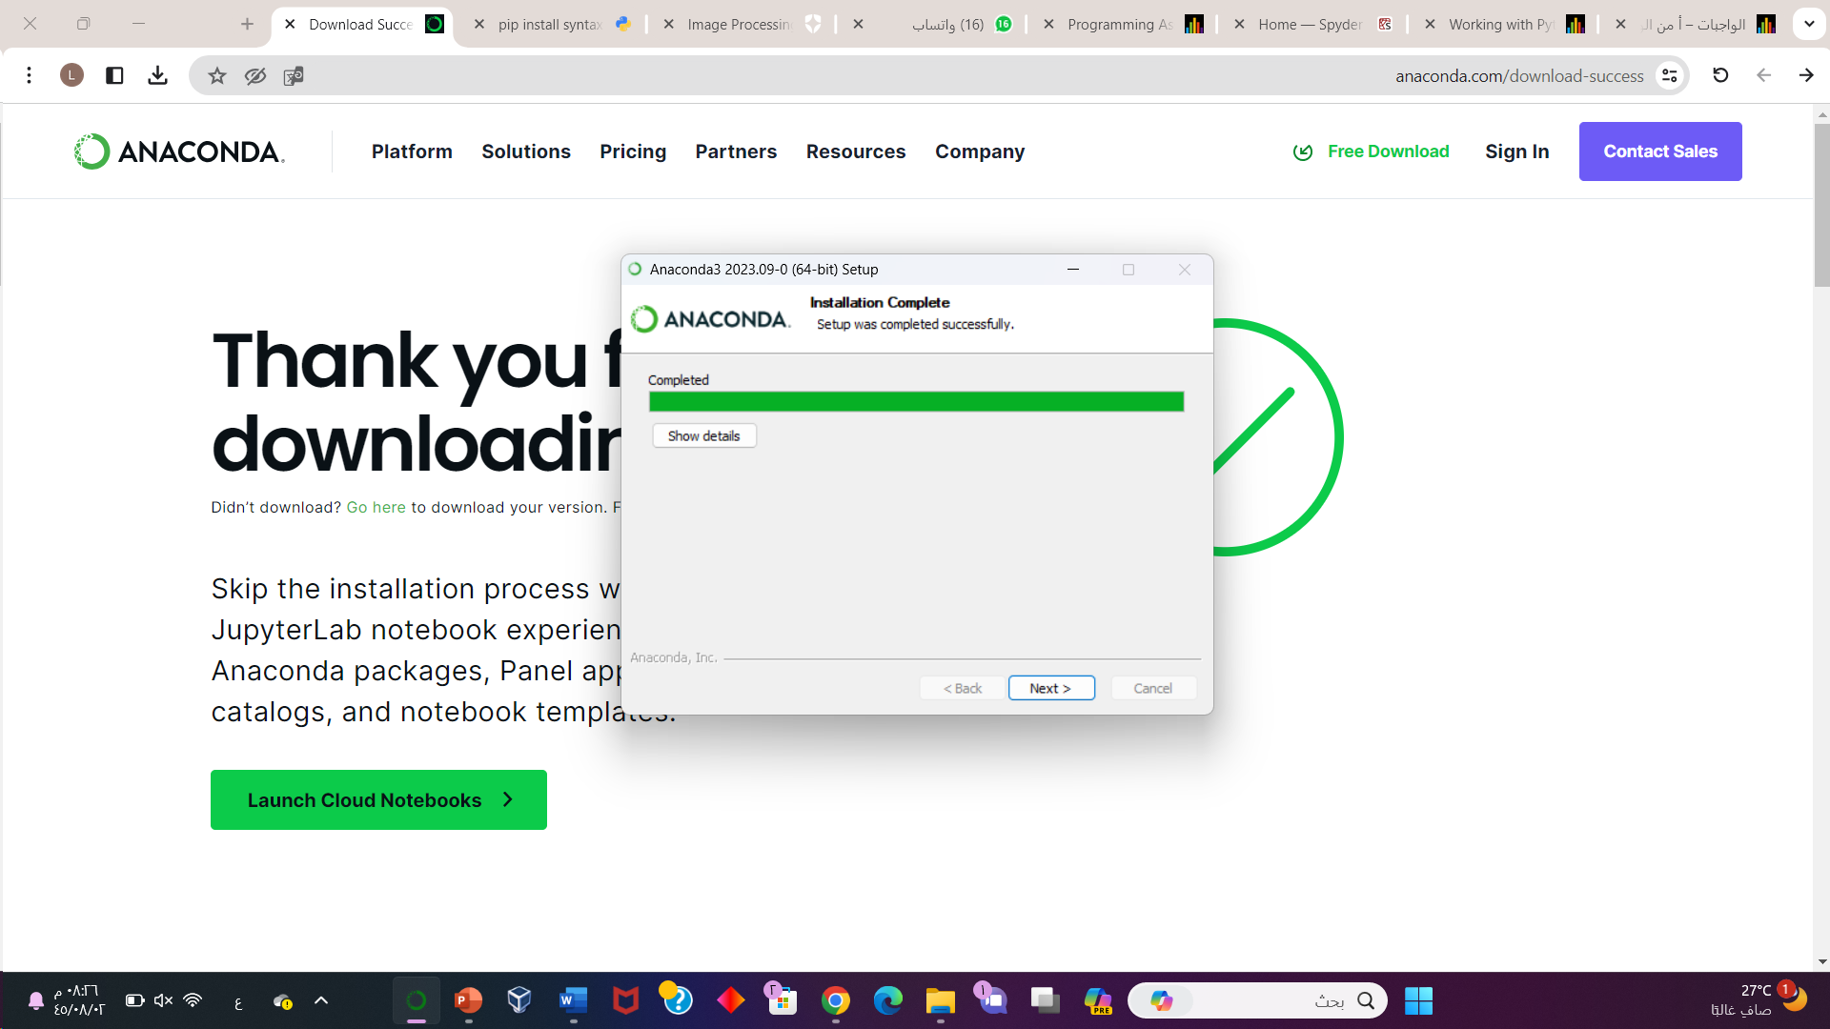
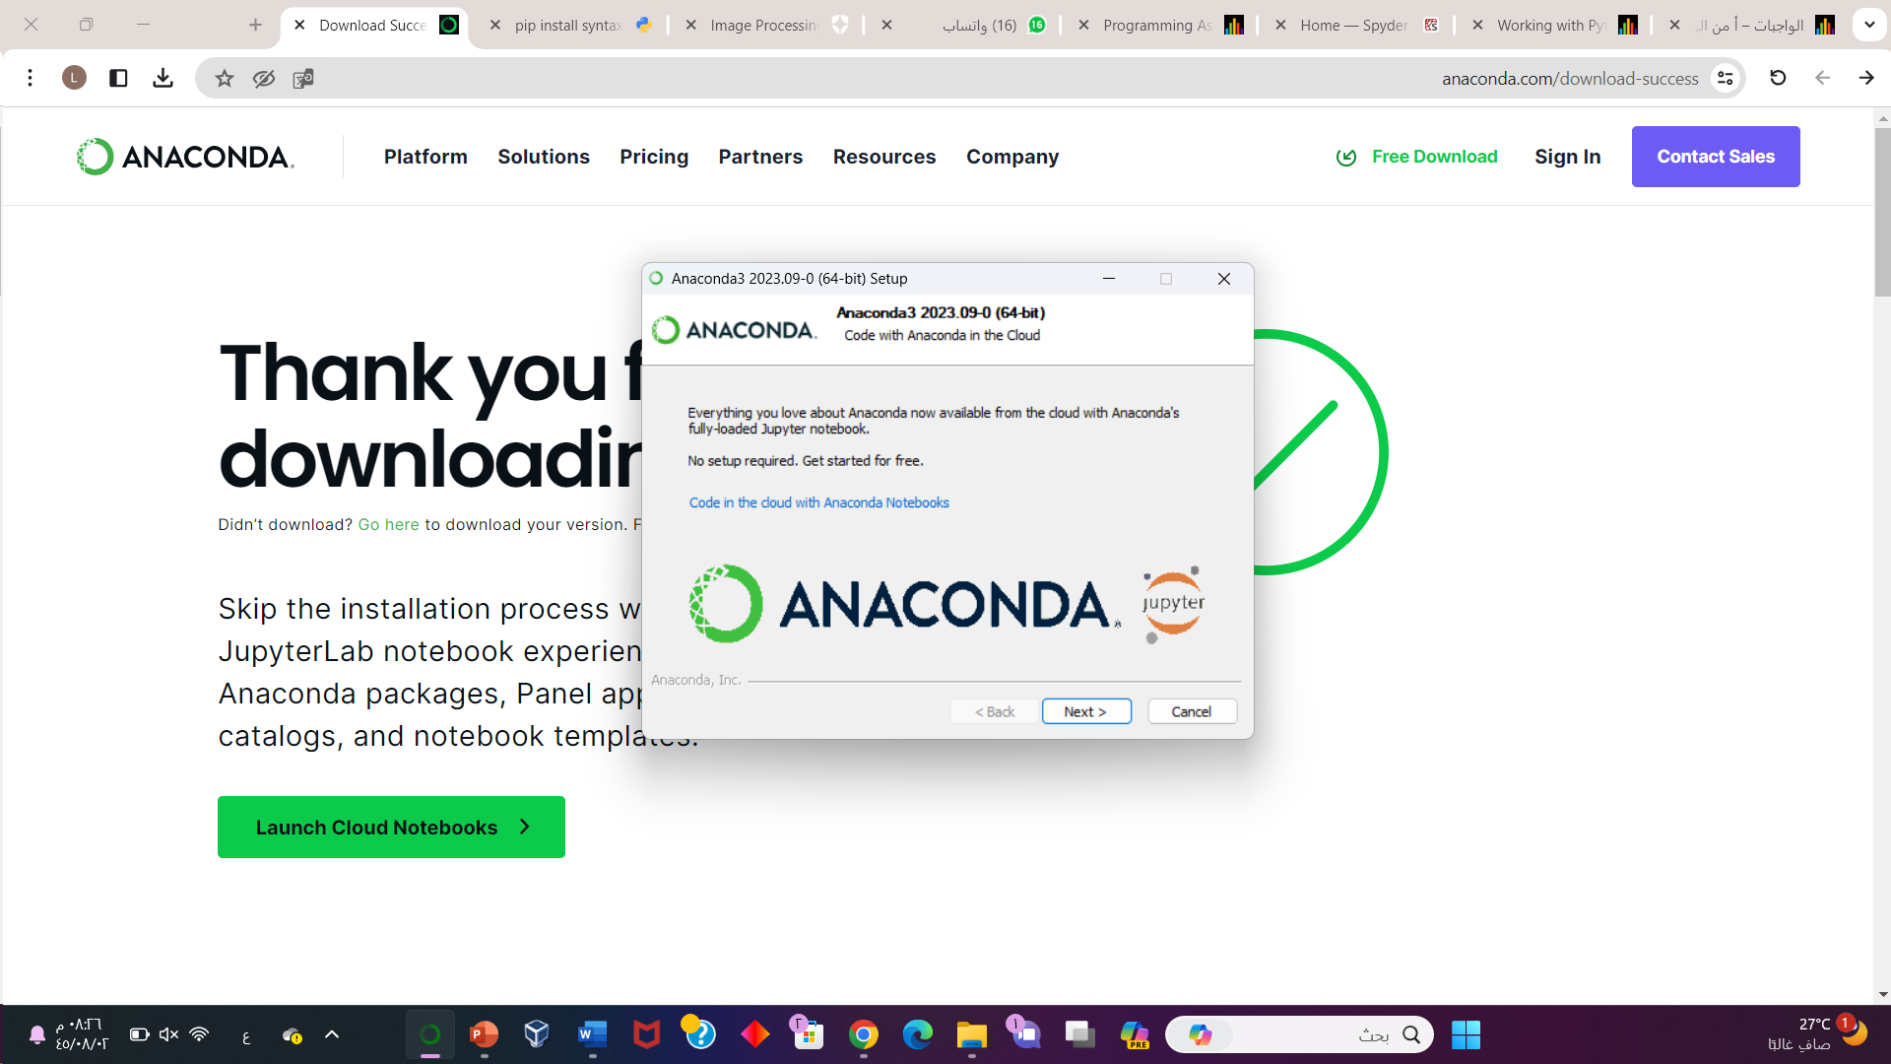

Slide 5
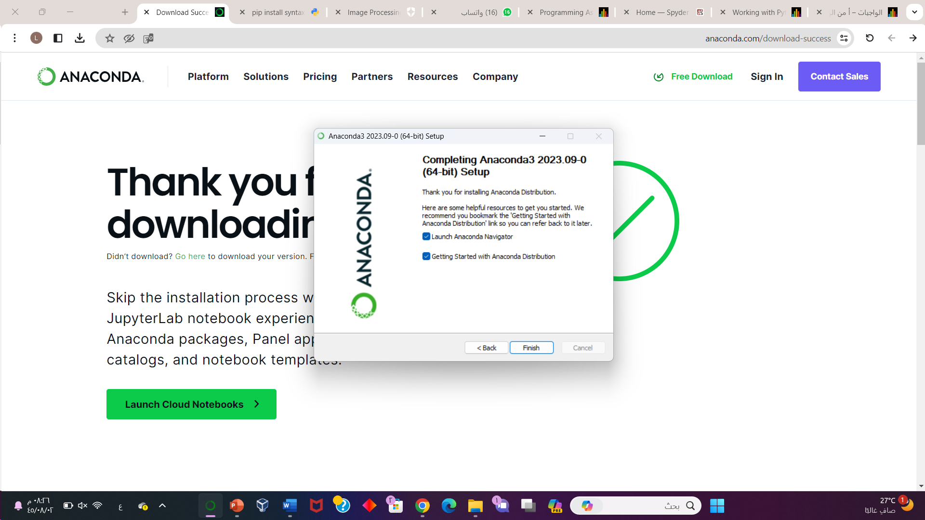
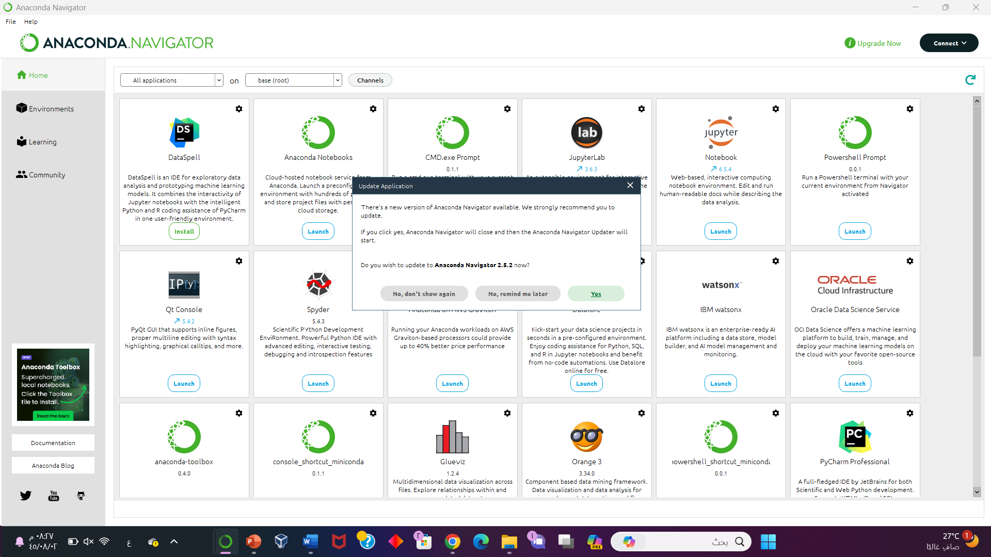
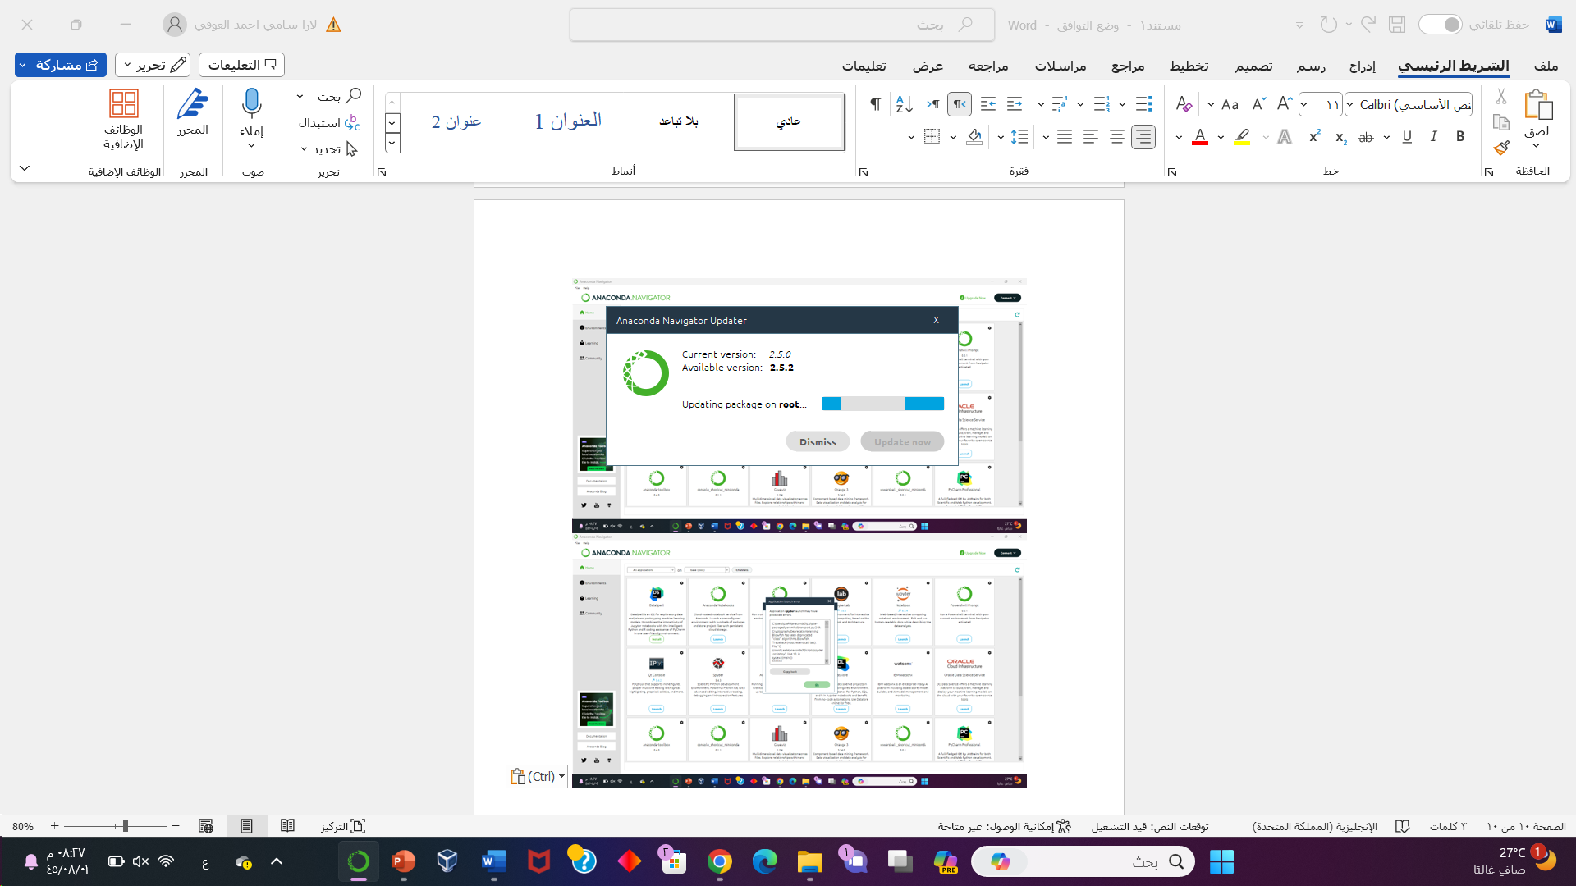
Here we download the library PIL with the command “pip install –upgrade Pillow”

Slide 6
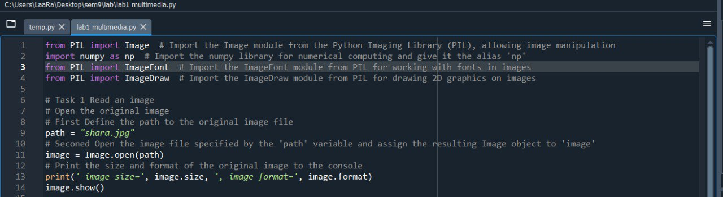
Task 1
Reads an image file named "shara.jpg" and prints its size and format. No modifications are made to the image in this task [1]

Slide 7
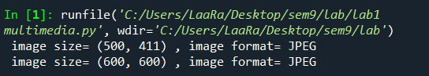
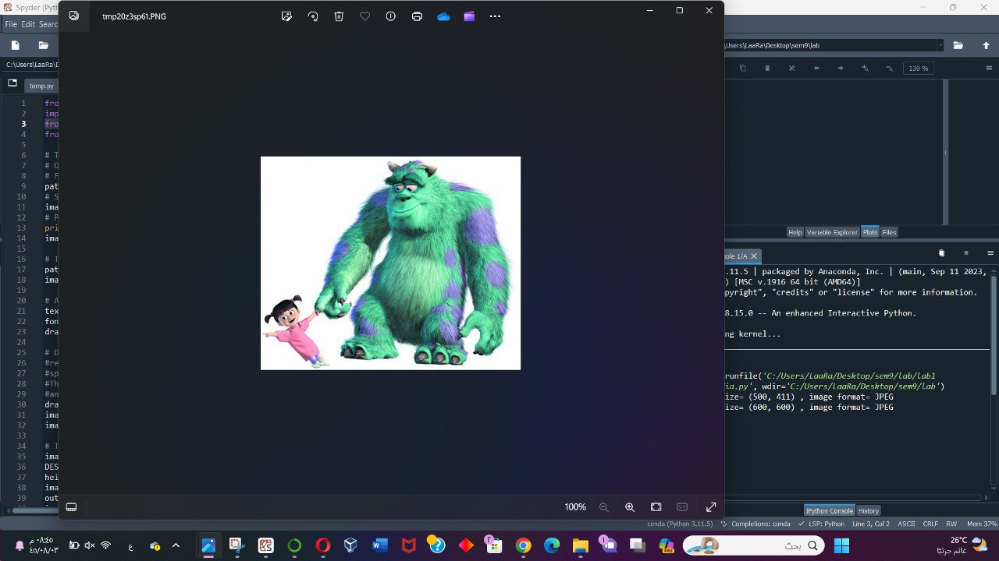
Output

Slide 8
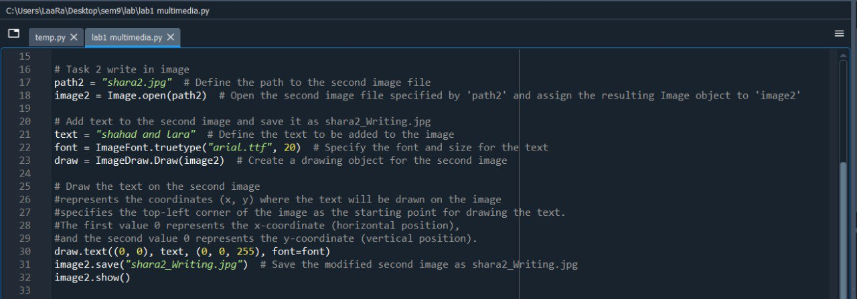
Task 2
Opens another image file named "shara2.jpg", adds the text "shahad and lara" to it, and saves the modified image as "shara2_Writing.jpg". This task demonstrates how to draw text on an image. [2]

Slide 9
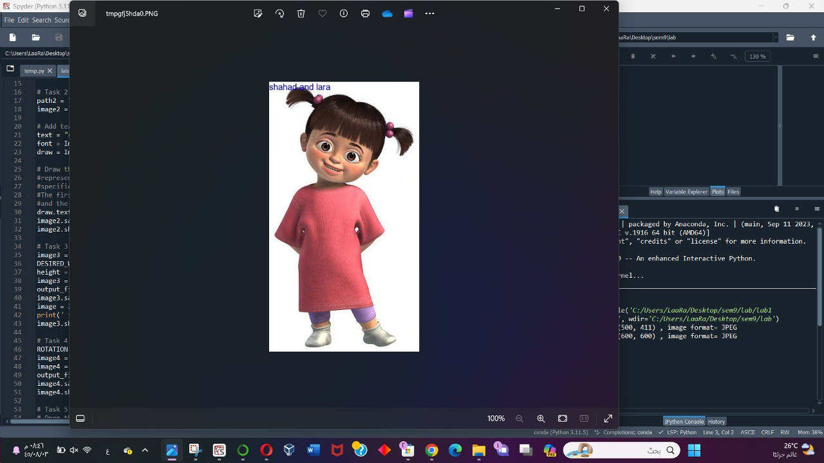
Output

Slide 10
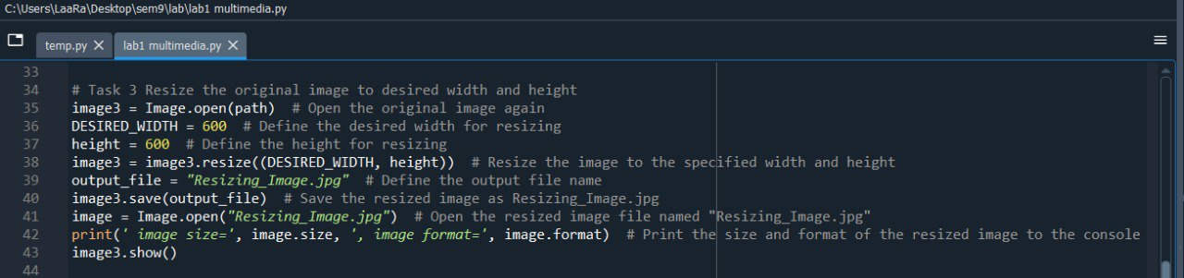
Task 3
Resizes the original image "shara.jpg" to a desired width of 600 pixels and a height of 600 pixels. The resized image is saved as "Resizing_Image.jpg". This task illustrates image resizing.[3]

Slide 11
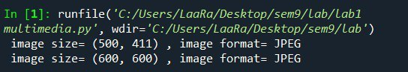
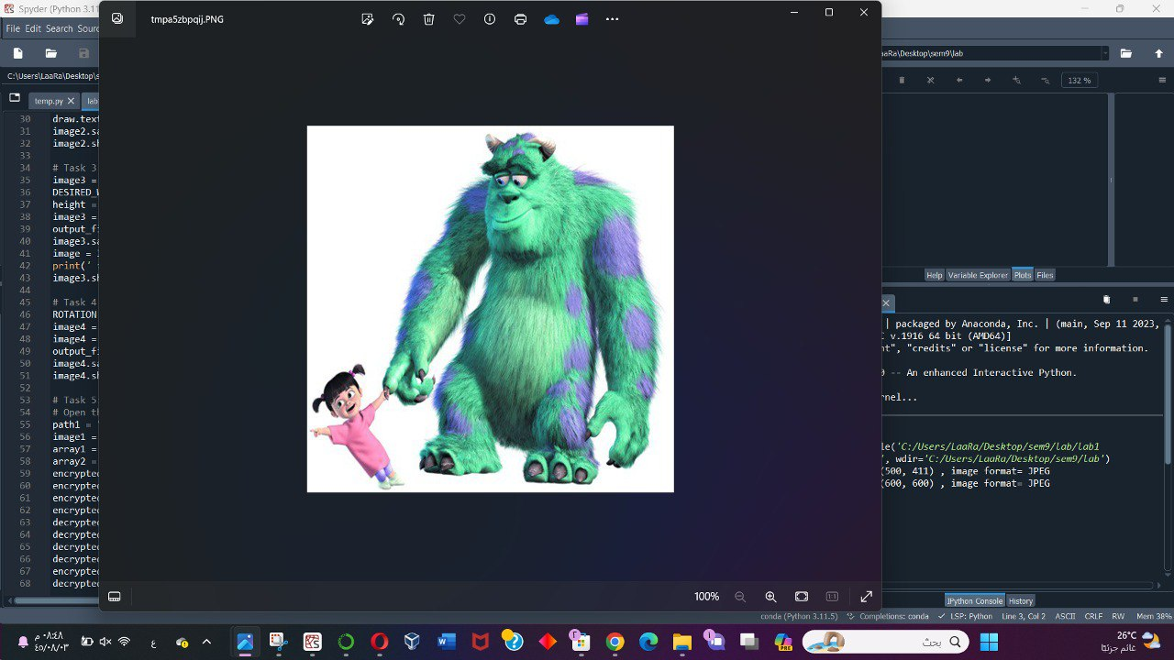
Output

Slide 12
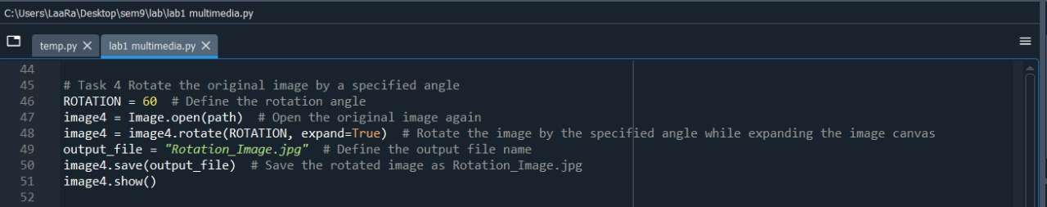
Task 4
Rotates the original image "shara.jpg" by an angle of 60 degrees while expanding the canvas to fit the entire rotated image. The rotated image is saved as "Rotation_Image.jpg". This task showcases image rotation.[3]

Slide 13
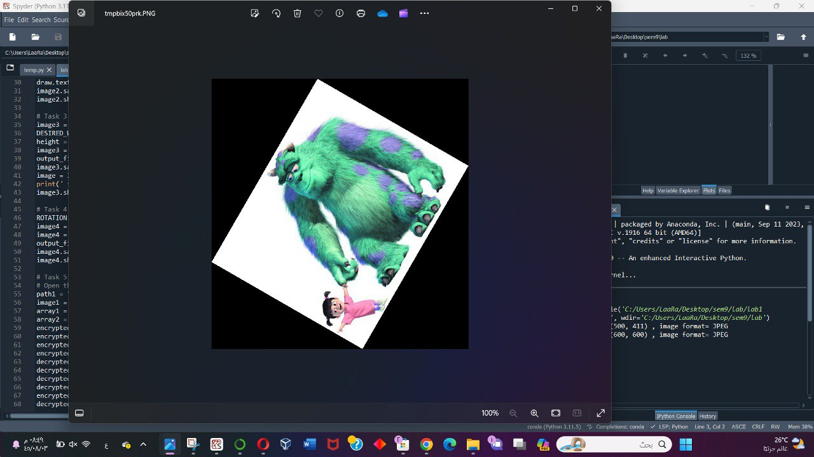
Output

Slide 14
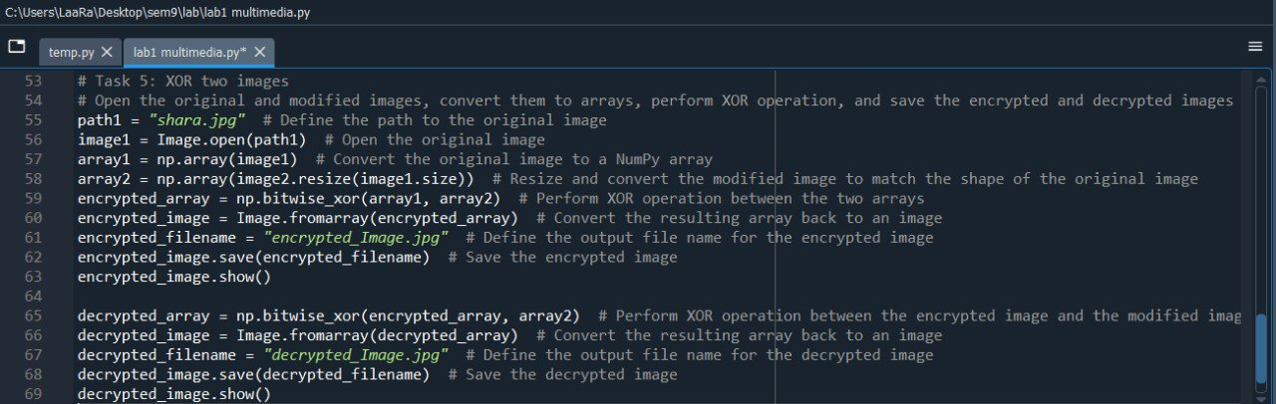
Task 5
XORs two images, "shara.jpg" (original) and "shara2_Writing.jpg" (modified). The resulting encrypted image is saved as "encrypted_Image.jpg". Then, it decrypts the encrypted image by XORing it with the modified image again, and saves the decrypted image as "decrypted_Image.jpg". This task demonstrates image encryption and decryption using XOR operations. [4]

Slide 15
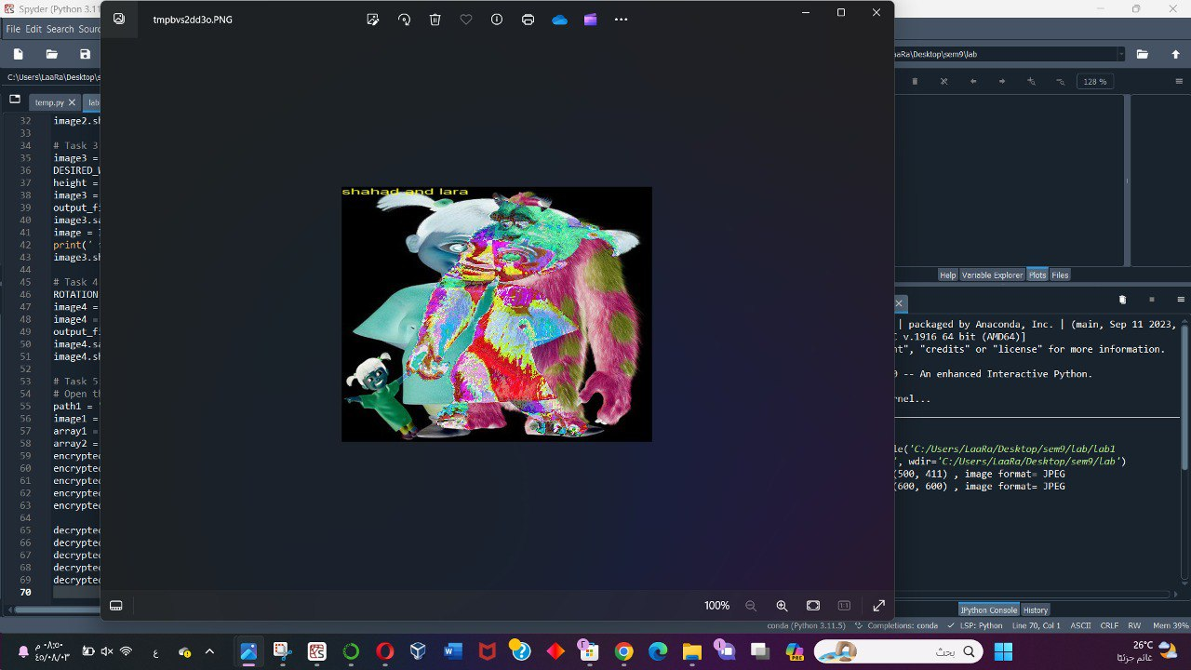
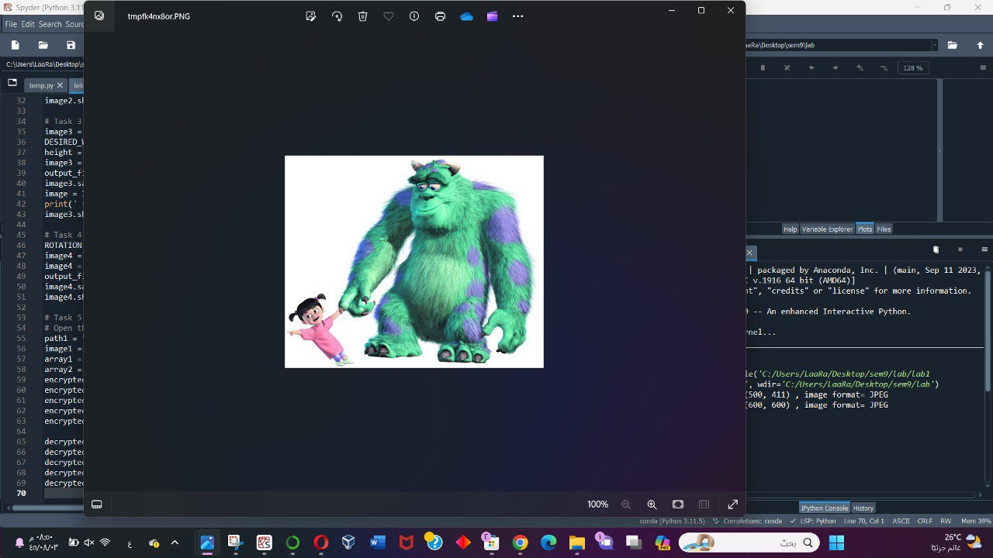
Output
Decrypted
Encrypted

Slide 16
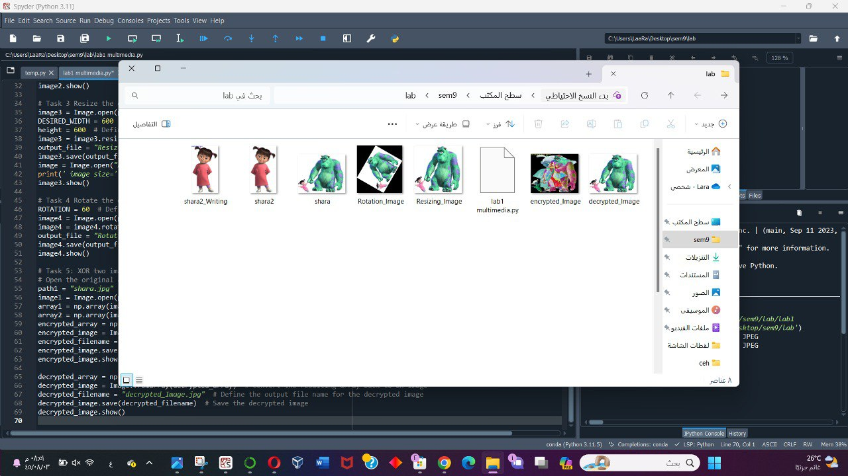

Slide 17
Refrencess
[1] "Python Imaging Library (PIL) Documentation,“ image.open method Pillow, 2022. [Online]. Available: https://pillow.readthedocs.io/en/stable/handbook/image-file-formats.html. [Accessed: Feb. 7, 2024].
[2] "Adding text on images using Python," GeeksforGeeks, 2022. [Online]. Available: https://www.geeksforgeeks.org/adding-text-on-image-using-python-pil/. [Accessed: Feb. 7, 2024].
[3] "Python Image Resize with Pillow and OpenCV," Cloudinary, 2022. [Online]. Available: https://cloudinary.com/guides/bulk-image-resize/python-image-resize-with-pillow-and-opencv. [Accessed: Feb. 7, 2024].
[4] "numpy.bitwise_xor," NumPy v1.22 Manual, 2022. [Online]. Available: https://numpy.org/doc/stable/reference/generated/numpy.bitwise_xor.html. [Accessed: Feb. 7, 2024].

